Slide 1

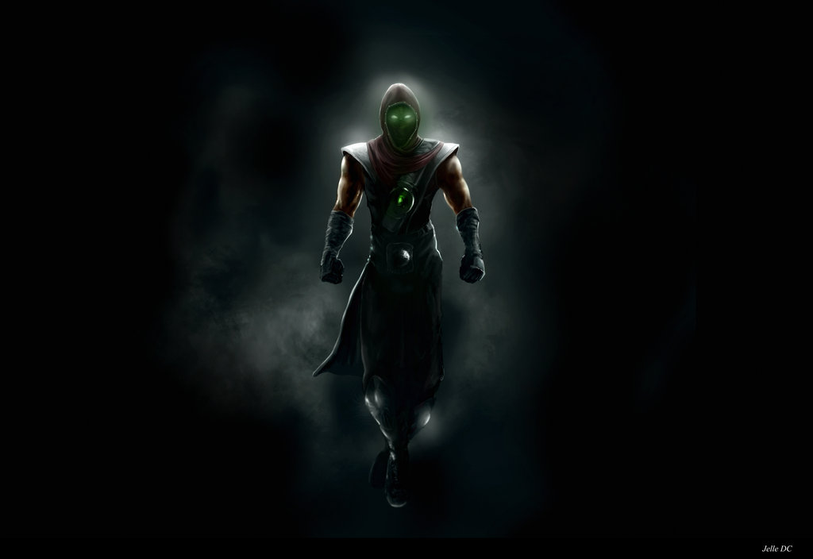
Teamwork project - JS UI & DOM 2014, July
http://academy.telerik.com
Client-side JavaScript application
Team Ermac

Slide 2

Starring
Human Resources

Slide 3
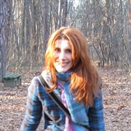
Collaborator
Names | Irina Kezhova
Main Project Role | Excuses finder
Additional Roles | Not available
Profile avatar

Slide 4

Collaborator
Names | Dzhenko Penev
Main Project Role | Architecture Design (OOP)
Additional Roles | One man army
Profile avatar

Slide 5
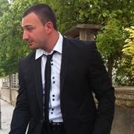
Collaborator
Names | Zhiko Mitov
Main Project Role | Algorithms
Additional Roles | Requirements, Specifications
Profile avatar

Slide 6
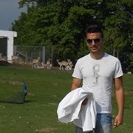
Collaborator
Names | Teodor Mihov
Main Project Role | KineticJS graphic
Additional Roles | Algorithms, Coordination
Profile avatar

Slide 7
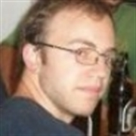
Collaborator
Names | Marko Kalaksyzov
Main Project Role | UI
Additional Roles | Requirements, Support
Profile avatar

Slide 8
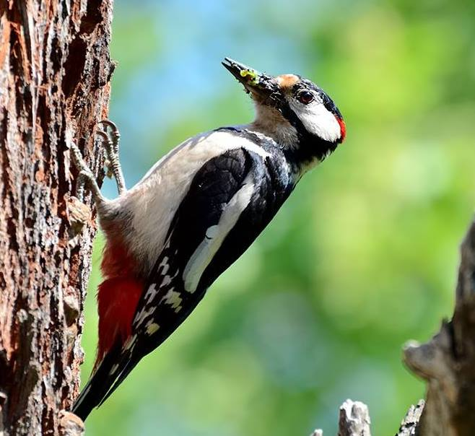
Collaborator
Names | Meroslav Tsaakoff
Main Project Role | SVG Animations
Additional Roles | Documentation
Profile avatar

Slide 9

Project Realization
Description, Implementation

Slide 10
Description
Summary
The main goal of the game is to fly with a spaceship as long as it’s possible.
Project opportunities
Easy to Implement logic
Many possibilities for all kind of features, animations, conditions and so on.

Slide 11
How to Play: Instructions
The spaceship flies in a horizontal direction from left to right, and from the right side it has to avoid the appearing meteors
Navigation is realized by the keys: a, s, d, w or with the arrows to avoid the meteors
The right panel represents a separate task, which solving gives the player additional fuel
After starting the game in the right panel appears an equation and several color bubbles
Selecting the correct answers of the equations with the mouse rises the fuel only if the selected bubble’s color corresponds to the color of the bubble with the equation inside
Selecting a wrong answer or a bubble with a different color than the equation’s will decrease the player’s fuel
The bottom panel shows the current fuel
The game has three levels of difficulty: normal, nightmare and hell

Slide 12
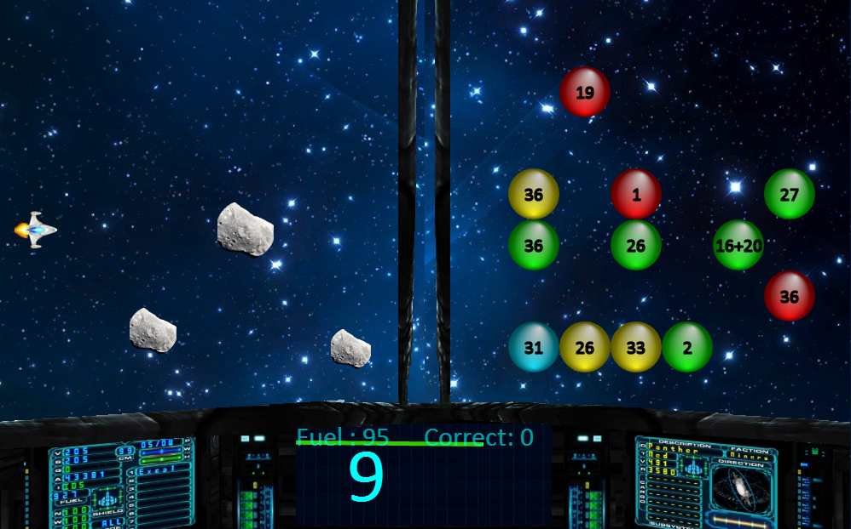
Screenshot of the Game

Slide 13
Requirements
HTML5 Canvas | Achieved
SVG | Achieved
Git repository | Achieved
jQuery | Achieved
Unit-tests | Achieved
OOP | Achieved

Slide 14
Team Contribution
Git
~70 commits, participated by almost every one in the team acting in any hour in the day and night
https://github.com/mitov90/BrainGame
Facebook
Polls for the most important decisions
Pictures from the offline meeting
Files and opinions transfers
https://facebook.com/groups/575414105908875/

Slide 15
Brain Game
Live Demo

Slide 16
CatchBall Realization
?
?
?
?
?
Questions?
?
?
?
?
?
http://academy.telerik.com

